Slide 1
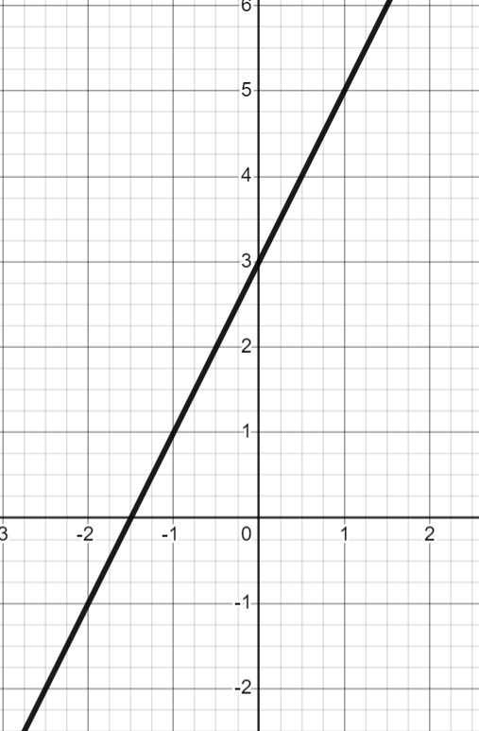
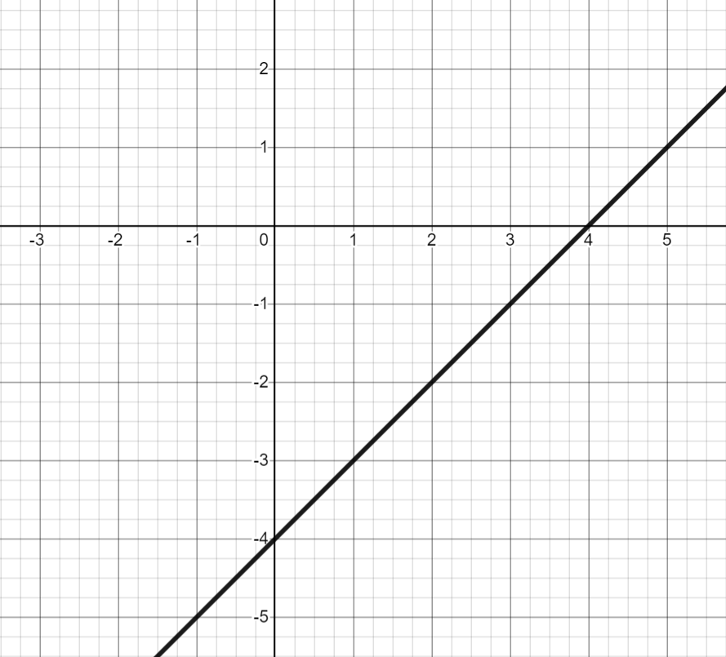
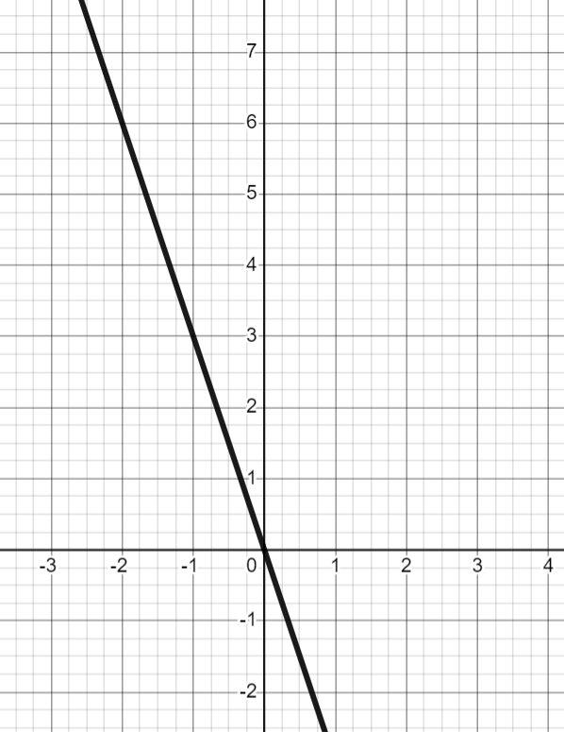
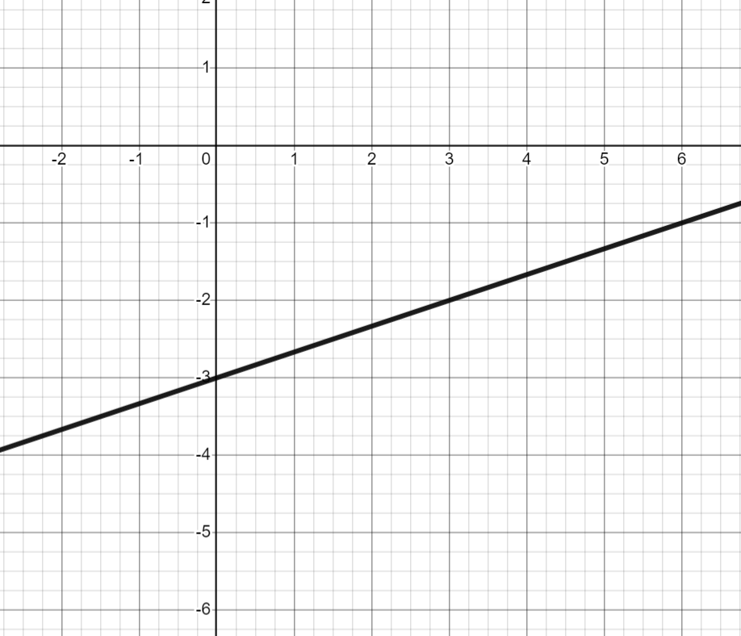
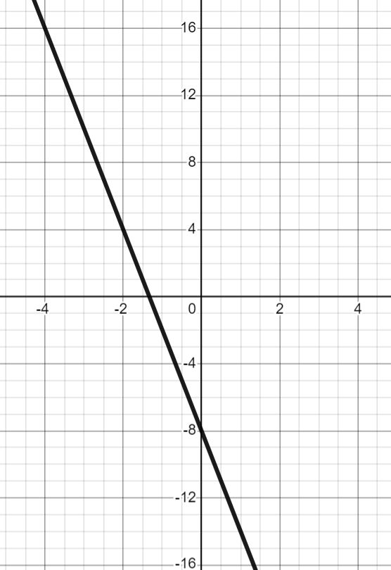
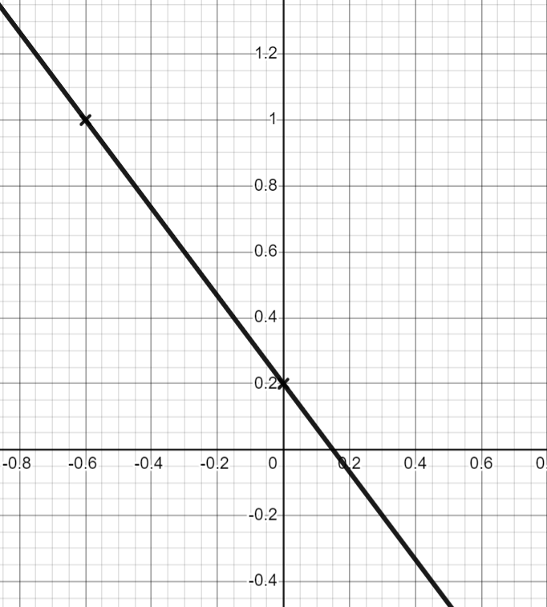


Finding the equation of the line y = mx + c
Task A: Writing the equation of a line from key features
1) For each graph, work out an equation for the line in the form y = mx + c
 | b) | c)
gradient: 2
y-intercept: (0, 3)
equation: y = 2x + 3
gradient: 1
y-intercept: (0, −4)
equation: y = x − 4
gradient: −3
y-intercept: (0, 0)
equation: y = −3x
d) | e) | f)
gradient:
y-intercept: (0, −3)
equation: y = x − 3
gradient: −6
y-intercept: (0, −8)
equation: y = −6x − 8
gradient:
y-intercept: (0, 0.2)
equation: y = x + 0.2

Slide 2
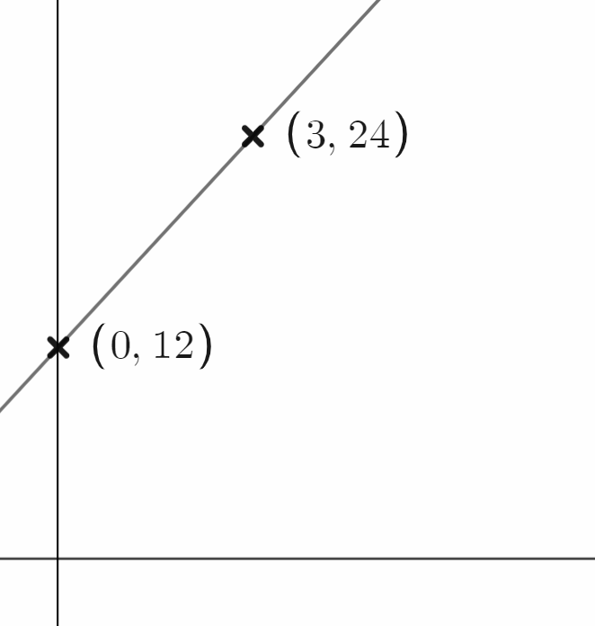
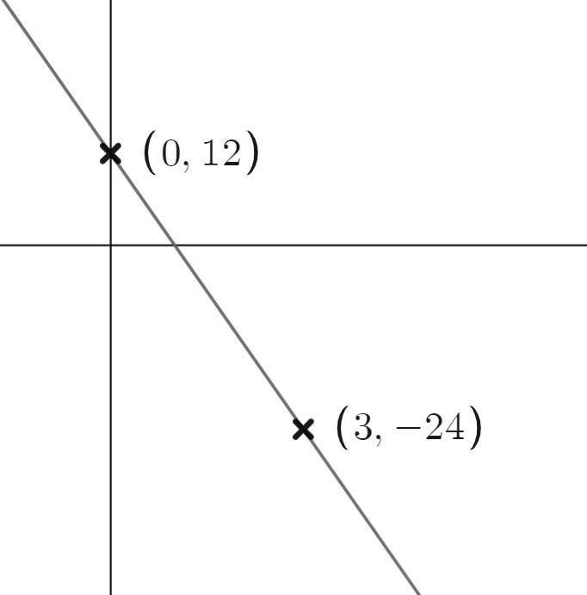
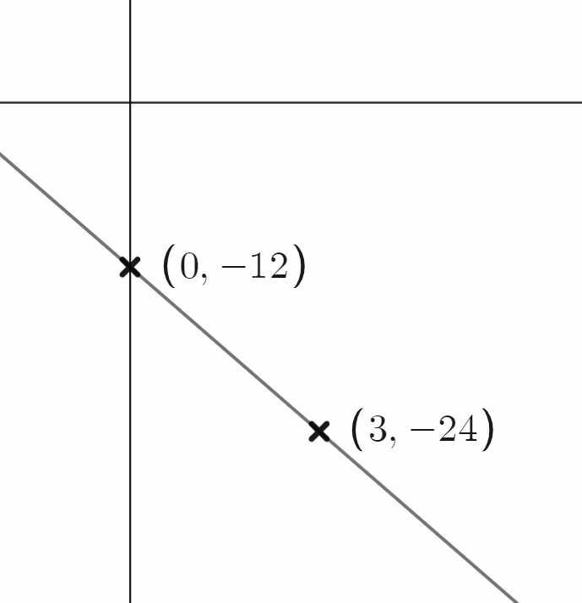
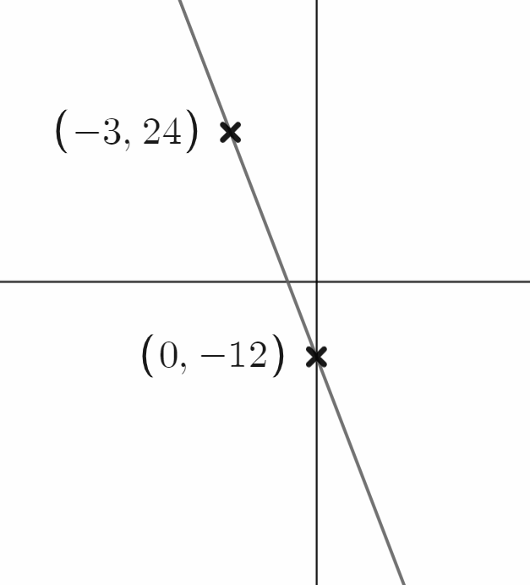
Finding the equation of the line y = mx + c
Task B: Finding the equation of a line
1) Calculate the equation of the line which has the table of values shown.
a)
b)
c)
d)
x | 0 | 1 | 2
y | −7 | −3 | 1
y = 4x −7
x | −1 | 0 | 1
y | 14 | 3 | −8
y = −11x + 3
x | 0 ….. | 1 | 2 | 3
y | 7 ….. | 5 | 3 | 1
y = −2x + 7
x | 0 ….. | 10 | 11 | 12
y | −22 …. | −12 | −11 | −10
y = x − 22
2) Calculate the equation of each line.
a) | b) | c) | d)
Change x | Change y
3 | 12
1 | 4
Change x | Change y
3 | −36
1 | −12
Change x | Change y
3 | −12
1 | −4
Change x | Change y
3 | −36
1 | −12
y = 4x + 12
y = −12x + 12
y = −4x − 12
y = −12x − 12
3) Calculate the equation of the line passing through the coordinates given
a) (3, 5) and (5, 13) | b) (3, 5) and (7, −15) | c) (3, 5) and (−2, 10) | d) (3, 5) and (−15, −1)
Change x | Change y
2 | 8
1 | 4
Change x | Change y
4 | −20
1 | −5
Change x | Change y
5 | −5
1 | −1
18 | 6
1
Gradient = 4
Gradient = −5
Gradient = −1
Gradient =
x | 0 … | 3 … | 5
y | −7 | 5 … | 13
x | 0… | 3 … | 7
y | 20 | 5 … | −9
x | 0 | … | 3
y | 8 | … | 5
x | 0 | … | 3
y | 4 | … | 5
Equation: y = 4x − 7
Equation: y = −5x + 20
Equation: y = −x + 8
Equation: y = x + 4
Mathematics in Education and Industry
v2.2

